Slide 1

Sync+ 2.0
CD542ICA H–Desay_EESE&CVPP parts
China EESE&CVPP
Updated on 2023-01-18
Desired Outcome
Awareness
Decision
Escalation Help
Think
Point of view
Plan to Implement
Implement

Slide 2
{CD542ICA_L_R05 PRO} Software overall status {yellow}
Software key info
  Refer SWAD for the details:
    MCU version:20221128_557_PRO
    SOC version:20221227_0856_G2F13_R05.PRO
    Verification scope and method:
    {Full verification} executed with pass rate 98.89%, 0P1 and 9P2 issues found and not fixed. Refer test report for detail.
Main changes compared with previous version, refer RN for the details, highlights listed below:
    Open P2 issue list with risk evaluation – refer slide 3-4
    Performance status– refer slide 5-7
    OTA status– refer slide 8
    DID test status-refer slide 9
Notes:
Add P1 weekly burn down chart

Slide 3

{CD542ICA _L_R05 PRO} Open P2 issue list with risk evaluation
行标签 | 计数项:状态
Analysis | 5
Developing | 1
Verification | 3
总计 | 9

Slide 4
{CD542ICA_L_R05 PRO} Open P2 issue list with risk evaluation
itme | Key | Summary | Priority | Status | comments
1 | AW2-13557 | [CD542ICA_L][偶现][DLNA]关闭手机热点模式或打开车机热点模式，一直显示加载中 | Gating | Analysis | 当前log里面缺少关键信息，需要复现后在进行分析 发生概率：偶现 恢复机制：重启后可恢复 风险评估：当前在台架进行了压测，暂未复现该问题，待复现后进一步分析，评估为低风险
2 | AW2-12450 | Phase-4:【偶发】TT08 416976 R04 FCPA无法播放视频，车辆己连接手机热点。 | Gating | Analysis | 百度侧分析爱奇艺无法播放为网络问题，转到desay侧分析，但当前log里面缺少关键信息，无法进行下一步分析 发生概率：偶现 恢复机制：/ 风险评估：车机播放在线视频强依赖，由于偶现问题，评估为低风险
3 | AW2-12370 | 【CD542ICA_L】【偶现】【DLNA】投屏加载时间长 | Gating | Analysis | 这是个偶现问题，当前log无，台架已在R04与R05压测，暂未复现问题 发生概率：偶现 恢复机制：重新投屏 风险评估：投屏视频强依赖与网络，台架压测无复现该问题，评估为低风险
4 | AW2-12087 | Phase-4:【必发】TT14 542-4D1.5T 416959 R05 FCPA 手机投屏到大屏时视频不能播放5：35 | Gating | Analysis | 这是个偶现问题，当前log无，台架已在R04与R05压测，暂未复现问题 发生概率：偶现 恢复机制：重新投屏 风险评估：投屏视频强依赖与网络，台架压测无复现该问题，评估为低风险
5 | AW2-12515 | Phase4:[CD542ICA_L][5%]When upgrading SOC through OTA, the task is stuck during downloading, and IVI reboot cannot recover the download | Gating | Analysis | OTA升级SOC下载任务 卡住，重启IVI无法恢复，，当前desay侧分析正常，还在澄清是否为测试方法问题，

Slide 5
{CD542ICA_L_R05 PRO} 性能测试状态
类别 | 序号 | 影响因素（新） | 权重 | R04 | R05 | CD542L R08 | R05 Target | 允许偏差上限 | 偏差 | 得分 | 分析 | Test Result
响应时间 | 1 | Power on第一帧动画播放 | 1 | 7.49 | 8 | 13.89 | 7.00 | 8.00 | 14% | 4.5 |  | Pass
响应时间 | 2 | Power on到Fast RVC显示 | 1 | 12.97 | 7.9 | 6.5 | 6.50 | 7.50 | 22% | 6 |  | Pass
响应时间 | 3 | Power on Launcher界面可见 | 1 | 25.61 | 26.6 | 23.07 | 20 | 21 | 33% | 3 | AW2-8656百度分析中 | Fail
响应时间 | 4 | Launcher显示到优先蓝牙重连完成 | 1 | 5.35 | 6.6 | 3.25 | 10 | 10.5 | -34% | 3 |  | Pass
响应时间 | 5 | Launcher显示到蓝牙音乐首次启动 | 1 | 1.85 | 1.3 | 3.08 | 3 | 3.45 | -57% | 5 |  | Pass
响应时间 | 6 | Launcher显示到FM首次启动 | 1 | 1.08 | 1.7 | 1.15 | 2 | 2.4 | -15% | 4 |  | Pass
响应时间 | 7 | Launcher显示到车机网络时间同步完成 | 0.5 | 11.58 |  | 13.9 | 18.8 | 19.74 | -100% |  |  | Pass
响应时间 | 8 | Power on开机动画过程中到Fast RVC显示 | 1 | 1.57 | 1.7 | 6.5 | 1.5 | 1.8 | 13% | 1 |  | Pass
响应时间 | 9 | Launcher显示到Fast RVC显示 | 2 | 0.9 | 1.4 | 1.01 | 1.5 | 1.8 | -7% | 8 |  | Pass
响应时间 | 10 | Launcher显示到优先设备BT音源恢复 | 1 | 8.6 | 8 | 12.12 | 8 | 9 | 38% | 4.5 |  | Pass
响应时间 | 11 | Launcher显示到FM音源恢复 | 1.5 | 1.53 | 0 |  | 2 | 2.4 | -100% | 7.5 |  | Pass
响应时间 | 12 | Launcher显示到车辆设置界面打开 | 0.5 | 2.39 | 2.5 | 2.82 | 2.2 | 2.64 | 14% | 2 |  | Pass
响应时间 | 13 | Launcher显示到空调设置界面打开 | 0.5 | 1.73 | 1.4 |  | 1.5 | 1.8 | -7% | 7.5 |  | Pass
响应时间 | 14 | Launcher显示到快捷菜单上点击空调按钮可用 | 0.5 | 0.36 | 0.6 | 3.57 | 0.5 | 0.65 | 20% | 2.5 |  | Pass
响应时间 | 15 | Launcher显示到SDM可用 | 0.5 | 2.39 |  | 4.96 | 7.2 | 8.2 | -100% |  |  | Pass
响应时间 | 16 | SDM硬按键切换成功 | 0.5 | 4.07 |  | 4.85 | 2.5 | 3 | -100% |  |  | Pass
响应时间 | 17 | Launcher显示到进入稳定运行阶段经过的时间 | 2 | 37.60 | 30.7 | 47.33 | 50 | 52.5 | -39% | 8 |  | Pass
响应时间 | 18 | 系统稳定状态下Setting首次启动 | 0.5 | 0.87 | 0.9 | 0.89 | 1.4 | 1.68 | -36% | 2.5 |  | Pass
响应时间 | 19 | 系统稳定状态下蓝牙音乐首次启动 | 1 | 1.72 | 1.4 | 3.07 | 2 | 2.4 | -30% | 5 |  | Pass
响应时间 | 20 | 系统稳定状态下FM首次启动 | 1 | 0.98 | 1.3 | 1.15 | 1.2 | 1.4 | 8% | 3 |  | Pass
响应时间 | 21 | 稳定状态下Launcher热启动 | 1 | 0.62 | 0.3 |  | 0.5 | 0.65 | -40% | 5 |  | Pass
响应时间 | 22 | 稳定状态下设置二级菜单切换速度 | 1 | 0.14 | 0.3 |  | 0.5 | 0.65 | -40% | 5 |  | Pass
响应时间 | 23 | Setting热启动 | 1 | 0.524 | 0.6 | 0.52 | 0.7 | 0.91 | -14% | 5 |  | Pass
Notes:
Add P1 weekly burn down chart

Slide 6
{CD542ICA_L_R05 PRO} 性能测试状态
类别 | 序号 | 影响因素（新） | 权重 | R04 | R05 | CD542ICA R08 | R05 Target | 允许偏差上限 | 偏差 | 得分 | 分析 | Test Result
响应时间 | 24 | 蓝牙音乐热启动 | 1 | 0.65 | 0.9 | 0.5 | 0.6 | 0.78 | 50% | 3 |  | Fail
响应时间 | 25 | FM热启动 | 1 | 0.22 | 0.6 | 0.5 | 0.6 | 0.78 | 0% | 4 |  | Pass
响应时间 | 26 | 稳定状态下主题切换 | 0.5 | 0.54 | 0.7 |  | 1 | 1.2 | -30% | 2.5 |  | Pass
响应时间 | 27 | air conditioner热启动时间 | 0.5 | 0.41 | 0.3 | 0.26 | 0.5 | 0.65 | -40% | 2 |  | Pass
响应时间 | 28 | 蓝牙电话开机恢复通话界面 | 0.5 | 7.24 | 8.2 |  | 10 | 10.5 | -18% | 2.5 |  | Pass
响应时间 | 29 | 蓝牙电话冷启动时间 | 1 | 2.28 | 0.9 | 8.14 | 2 | 2.4 | -55% | 5 |  | Pass
响应时间 | 30 | 蓝牙电话热启动时间 | 0.5 | 0.55 | 0.7 | 0.4 | 1 | 1.2 | -30% | 1.5 |  | Pass
响应时间 | 31 | 投屏冷启动时间 | 0.5 | 0.83 |  | 1.8 | 1 | 1.2 | -100% |  |  | Pass
响应时间 | 32 | 精简屏幕冷启动时间 | 0.5 | 0.78 | 0.8 | 1.97 | 1.5 | 1.8 | -47% | 2.5 |  | Pass
响应时间 | 33 | 精简屏幕热启动时间 | 0.5 | 0.55 | 0.6 | 0.66 | 1.3 | 1.56 | -54% | 1.5 |  | Pass
Notes:
Add P1 weekly burn down chart

Slide 7
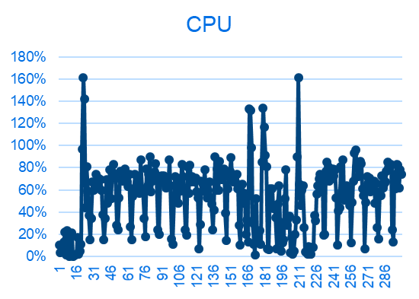
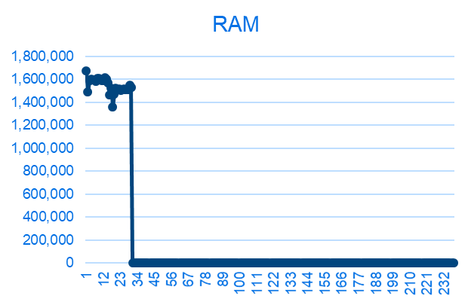
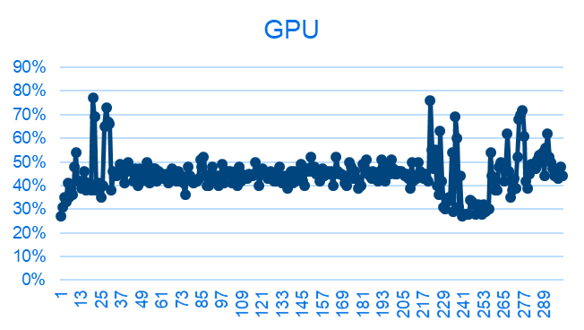
{CD542ICA_L_R05 PRO} 性能状态
影响因素（新） | 权重 | R05 | 分析 | Test Result
24小时Monkey测试中的CPU Free | 1 |  |  | pass
24小时Monkey测试中的RAM Free | 1 |  |  | pass
24小时Monkey测试中的GPU Free | 1 |  |  | pass
24小时Monkey中的ANR次数 | 1 |  |  | pass
24小时Monkey中的Crash次数 | 1 | 0 |  | pass
24小时Monkey中内存泄露进程数 | 1 | 0 |  | pass
8小时Monkey测试-设置 | 0.5 | 0 |  | pass
8小时Monkey测试-蓝牙音乐 | 0.5 | 0 |  | pass
8小时Monkey测试-蓝牙电话 | 0.5 | 0 |  | pass
8小时Monkey测试（其他所属应用） | 0.5 | 0 |  | pass
CPU Free
RAM Free
GPU Free
Notes:
Add P1 weekly burn down chart

Slide 8
{CD542ICA_L_R05 PRO} OTA测试状态
Title: |  | Verification Test Report For OTA
Function Name | Total Test Case |  | Passed Test Case | Failed Test Case | Percentage of Test Completion: | Test Cases Pass Percentage:
TC_SOC_OTA | 84 |  | 76 | 0 | 90.48% | 100.00%
TC_MCU_OTA | 74 |  | 70 | 0 | 94.59% | 100.00%
TC_MCU_USB | 66 |  | 65 | 1 | 98.48% | 100.00%
TC_SOC_USB | 66 |  | 65 | 0 | 98.48% | 100.00%
Total | 290 |  | 276 | 1 | 95.17% | 100.00%
Test Summary Description
升级成功后无 VIL 文件
R05 PRO 版本冒烟测试结果Pass
Notes:
Add P1 weekly burn down chart

Slide 9
{CD542ICA_L_R05 PRO} DID 测试状态
DID | EXPECTED #PART | RECEIVED #PART | RESULT
F113 | PB6T-18D668-KC | PB6T-18D668-KA | Fail
F111 | PB6T-14H370-KB | PB6T-14H370-KA | Fail
F188 | PB6T-14H361-AC | PB6T-14H361-AC | Pass
F10A | ~MB6T-14H369-AC | ~MB6T-14H369-AC | Pass
F16B | PB6T-14H375-AA | PB6T-14H375-AA | Pass
F16C | PB6T-14H376-AA | PB6T-14H376-AA | Pass
F16D | NA | NA | NA
F16E | NA | NA | NA
8033 | PB6T-14H379-BC | PB6T-14H379-BC | Pass
F180 | MB6T-14H368-AD | MB6T-14H368-AD | Pass
F110 | DSMB6T-18D668-AH | DSMB6T-18D668-AH | Pass
F163 | 5 | 5 | Pass
F162 | 7 | 7 | Pass
    Note :F113/F111 --为硬件烧录标定，刷软件时无法更新

